Slide 1
Chapter 12
Electronic Payment Systems

Slide 2
Learning Objectives
Understand the shifts that are occurring with regard to noncash and online payments.
Discuss the players and processes involved in using credit cards online.
Discuss the different categories and potential uses of smart cards.
Discuss various online alternatives to credit card payments and identify under what circumstances they are best used.

Slide 3
Learning Objectives
Describe the processes and parties involved in e-checking.
Describe payment methods in B2B EC, including payments for global trade.
Discuss electronic bill and invoice presentment and payment.
Understand the sales tax implications of e-payments.

Slide 4
The Payment Revolution
Some crucial factors come into play in determining whether a particular method of
e-payment achieves critical mass:
  Independence
  Interoperability and portability
  Security
  Anonymity
  Divisibility
  Ease of use
  Transaction fees
  Regulations

Slide 5
The Payment Revolution
Using Payment Cards Online
  payment card
  Electronic card that contains information that can be used for payment purposes
  Payment cards come in three types:
    Credit cards
    Charge cards
    Debit cards

Slide 6
The Payment Revolution
Processing Cards Online
  authorization
  Determines whether a buyer’s card is active and whether the customer has sufficient funds
  settlement
  Transferring money from the buyer’s to the merchant’s account

Slide 7
The Payment Revolution
Three basic configurations for processing online payments. Merchants may:
  Own the payment software
  Use a point of sale system (POS) operated by an acquirer
    payment service provider (PSP)
    A third-party service connecting a merchant’s EC systems to the appropriate acquirers. PSPs must be registered with the various card associations they support
  Use a POS operated by a payment service provider

Slide 8
The Payment Revolution
The key participants in processing card payments online include:
  Acquiring bank
  Credit card association
  Customer
  Issuing bank
  Merchant
  Payment processing service
  Processor

Slide 9
The Payment Revolution
Fraudulent Card Transactions
  In the online world, merchants are held liable for fraudulent transactions
  Merchants can incur additional fees and penalties imposed by the card associations
  Costs associated with combating fraudulent transactions are also the merchant’s responsibility

Slide 10
The Payment Revolution
The key tools used in combating fraud:
  Address Verification System (AVS)
  Detects fraud by comparing the address entered on a Web page with the address information on file with the cardholder’s issuing bank
  Manual review
  Fraud screens and automated decision models

Slide 11
The Payment Revolution
The key tools used in combating fraud:
  card verification number (CVN)
  Detects fraud by comparing the verification number printed on the signature strip on the back of the card with the information on file with the cardholder’s issuing bank
  Card association payer authentication services
  Negative files

Slide 12
The Payment Revolution
virtual credit card
An e-payment system in which a credit card issuer gives a special transaction number that can be used online in place of regular credit card numbers
smart card
An electronic card containing an embedded microchip that enables predefined operations or the addition, deletion, or manipulation of information on the card

Slide 13
Smart Cards
contact card
A smart card containing a small gold plate on the face that when inserted in a smart card reader makes contact and passes data to and from the embedded microchip
contactless (proximity) card
A smart card with an embedded antenna, by means of which data and applications are passed to and from a card reader unit or other device without contact between the card and the card reader

Slide 14
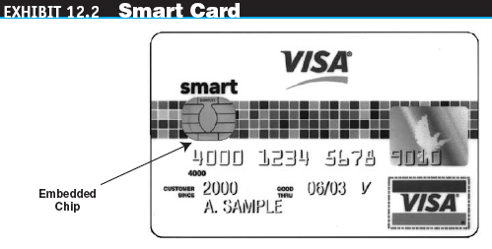
Smart Cards

Slide 15
Smart Cards
smart card reader
Activates and reads the contents of the chip on a smart card, usually passing the information on to a host system
smart card operating system
Special system that handles file management, security, input/output (I/O), and command execution and provides an application programming interface (API) for a smart card

Slide 16
Smart Cards
Applications of Smart Cards
  Retail Purchases
  Transit Fares
  E-Identification
  Health Care
Securing Smart Cards
  Smart cards are more secure than conventional payment cards

Slide 17
Stored-Value Cards
stored-value card
A card that has monetary value loaded onto it and that is usually rechargeable
  Anyone can obtain a stored-value card without regard to prior financial standing or having an existing bank account as collateral
  The stored-value card market is growing rapidly

Slide 18
E-Micropayments
e-micropayments
Small online payments, typically under $10

Slide 19
E-Micropayments
Five basic micropayment models that do not depend solely or directly on credit or debit cards:
  Aggregation
  Direct payment
  Stored value
  Subscriptions
  Ála Carte

Slide 20
E-Checking
e-check
A legally valid electronic version or representation of a paper check

Slide 21
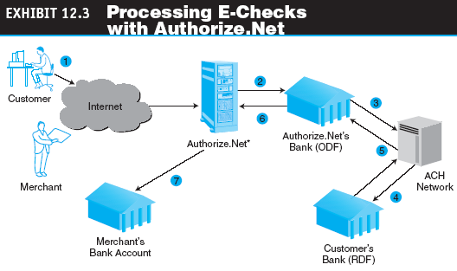
E-Checking

Slide 22
E-Checking
Automated Clearing House (ACH) Network
A nationwide batch-oriented electronic funds transfer system that provides for the interbank clearing of electronic payments for participating financial institutions

Slide 23
E-Checking
Benefits of E-Checks
  Reduces the merchant’s administrative costs
  Improves the efficiency of the deposit process for merchants and financial institutions
  Speedier during the checkout process for consumers
  Provides consumers with more information about their purchases on their account statements
  Reduces the float period and the number of checks that bounce because of insufficient funds (NSFs)

Slide 24
Electronic Bill Presentment and Payment
electronic bill presentment and payment (EBPP)
Presenting and enabling payment of a bill online. Usually refers to a B2C transaction

Slide 25
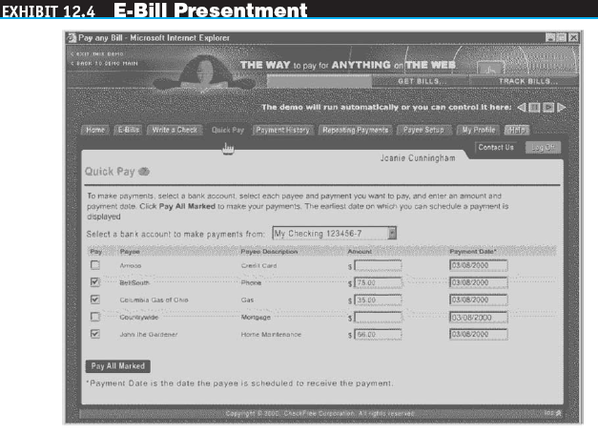
Electronic Bill Presentment and Payment

Slide 26
Electronic Bill Presentment and Payment
Types of E-Billing
  Online banking
  Biller direct
  Bill consolidator

Slide 27
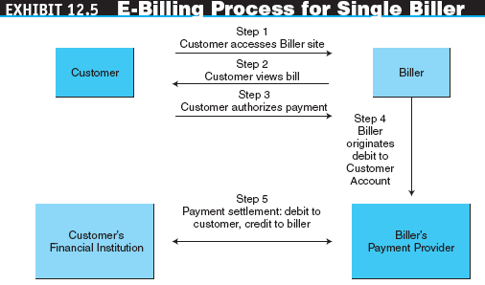
Electronic Bill Presentment and Payment

Slide 28
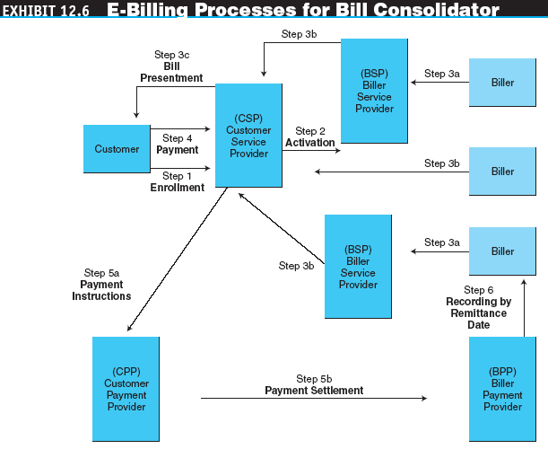
Electronic Bill Presentment and Payment

Slide 29
Electronic Bill Presentment and Payment
Advantages of E-Billing
  The reduction in expenses related to billing and processing payments
  Advertising: electronic inserts can be customized to the individual customer

Slide 30
Electronic Bill Presentment and Payment
  Reduces the customer’s expenses by eliminating the cost of checks, postage, and envelopes
  Simplifies and centralizes payment processing and facilitates better record keeping
  Customers can review and pay bills at virtually any time

Slide 31
B2B Electronic Payments
Current B2B Payment Practices
    B2B payments are part of a much larger financial supply chain that includes:
    Procurement
    Contract administration
    Fulfillment
    Financing
    Insurance
    Credit ratings
    Shipment validation
    Order matching
    Payment authorization
    Remittance matching
    General ledger accounting

Slide 32
B2B Electronic Payments
More organizations have indicated a willingness to migrate from checks to electronic payments in the future because of:
  Current payment practices
  Electronic payments
  Role of EDI
  Integration of electronic payment and accounting systems
  Barriers to electronic payment
  Prospects for electronic payments

Slide 33
B2B Electronic Payments
enterprise invoice presentment and payment (EIPP)
Presenting and paying B2B invoices online

Slide 34
B2B Electronic Payments
EIPP Models
  Seller direct
  Buyer direct
  Consolidator

Slide 35
B2B Electronic Payments
EIPP Options
  ACH network
  Purchasing cards (p-cards)
  Fedwire or wire transfer
  Letters of credit for global payments

Slide 36
B2B Electronic Payments
purchasing cards (p-cards)
Special-purpose payment cards issued to a company’s employees to be used solely for purchasing nonstrategic materials and services up to a preset dollar limit
letter of credit (LC)
A written agreement by a bank to pay the seller, on account of the buyer, a sum of money upon presentation of certain documents

Slide 37
The Sales Tax Issue
A 1992 ruling by the U.S. Supreme Court held that a state cannot force out-of-state businesses to collect sales taxes unless the business has a physical presence—a store, factory, or distribution center—in the state
Researchers at the University of Tennessee estimate that in the United States, state and local governments have lost $15.5 billion in sales taxes because of online sales

Slide 38
The Sales Tax Issue
Because of the complexities, many online businesses (B2C and B2B) rely on specialized third-party software and services to calculate the taxes associated with a sale

Slide 39
The Sales Tax Issue
Representative companies that offer software and services to handle the detailed computations and keep abreast of tax law changes include:
  Salestax.com
  Sales Tax Clearinghouse
  Cybersource

Slide 40
Managerial Issues
What B2C payment methods should we use?
What B2B payment methods should we use?
Should we use an in-house payment mechanism or outsource it?
How secure are e-payments?

